Slide 1
FLUTTER WORKSHOP

Slide 2

Agenda
Installation and set-up
What is Flutter?
Why Flutter?
Overview of Flutter architecture
Quick review of Functions, Classes, and Objects - Demo
2

Slide 3
Installation
Download Android Studio https://developer.android.com/studio
Download Git https://git-scm.com/downloads
We will provide you with a demo on how to set up your code editor ☺
3

Slide 4
What is Flutter?
Mobile UI for creating apps for both iOS and Android systems
One code-base for both operating systems
Uses Dart as a programming language
4

Slide 5
Why use Flutter?
Easy to use with only 1 code base
Has great documentation and guides
Integrates with Firebase (Online Database often used as a backend service)
It is an open-source framework
Flexible to allow user to customize design

Slide 6
Apps currently made with Flutter
Pairing
Meeve
n8
Topline
Music Tutor
JD Finance
Google Ads
SG Bus Tracker
6

Slide 7
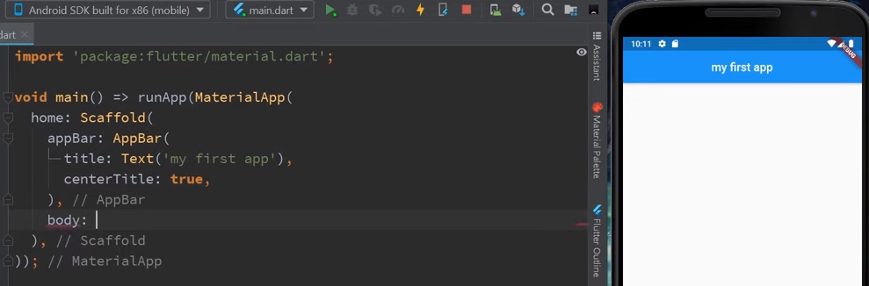
Scaffold Widget
A Scaffold Widget is basically a wrapper to a few different layout widgets.
For example, the app bar, the body, and a floating action button.
Provides a framework which implements the basic material

Slide 8
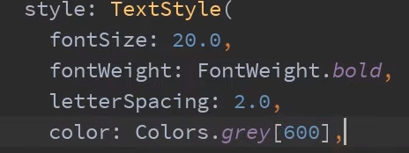
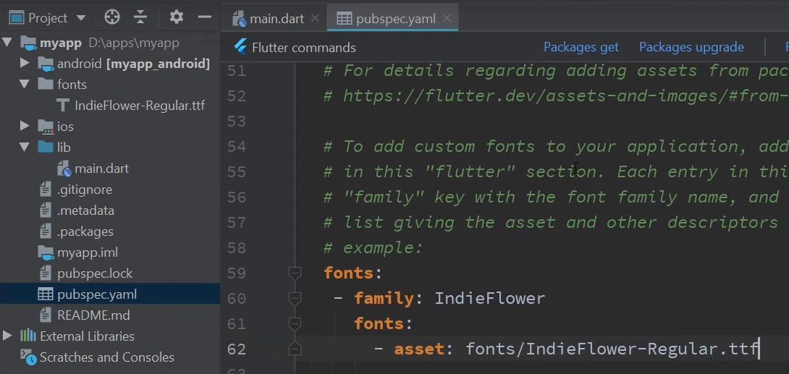
Text Style widget
Allows you to customize text
Allows you to change text:
Font size
Ability to bold text
Letter spacing
Color
Font
8
Notes:
Allows you to customize the style of your text
Custom fonts can also be addedto android studio to be added to the texts.

Slide 9
Hot Reload
Hot reload feature helps you quickly
Easily experiment
Build User Interfaces’
Add features
Fix bugs
Injecting updated source code files into the running Dart Virtual Machine (VM). After the VM updates classes with the new versions of fields and functions, the Flutter framework automatically rebuilds the widget tree, allowing you to quickly view the effects of your changes.

Slide 10
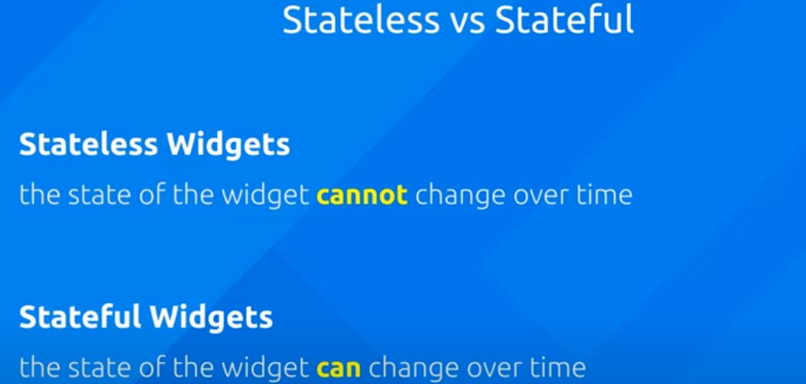
Stateless Widgets Vs Stateful Widgets

Slide 11
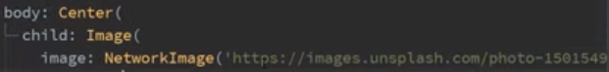
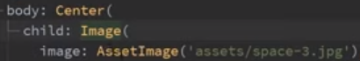
Image widget
Images can be added via online links or files from your desktop.
NetworkImage()
displays images from the internet
You can copy a url by right clicking an image online and clicking “copy image url”
Assetimage()
Inputs local image on your personal computer.
11
Notes:
To save time you can just add a folder that contains the images. This allows you to use any images inside that folder.

Slide 12

How does flutter operate?
Root Widget
App title
Information about your app
App Bar Widget
Container Widget
Text Widget
Text Widget

Slide 13
How does Flutter operate?
A combination of widgets
Common widgets that are used include:
Text widget
Button widget
Row widget
Column widget
Image widget

Slide 14
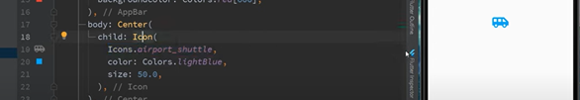
Icons
Icon is a widget that can be added to the app to show symbols. To do this set Icon as a child class
Within the child class of icon, you can specify which icon you want, the color, size etc.
14

Slide 15
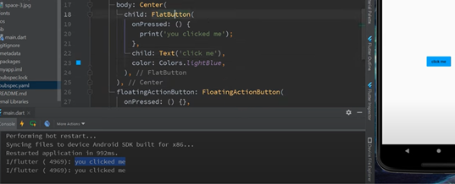
Button
Create a child class and specify what type of button you want. It can be a flat button or a raised button
onPressed : When the button is pressed a functions will be executed. This case it will state you clicked me
Child: text (will appear in the button)
Color: can use any color you want
If you press Control +Q it will list all the other attributes that can be apart of the button class

Slide 16
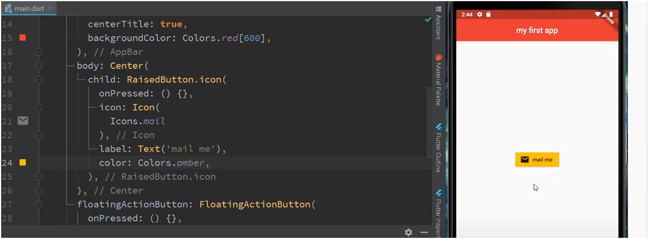
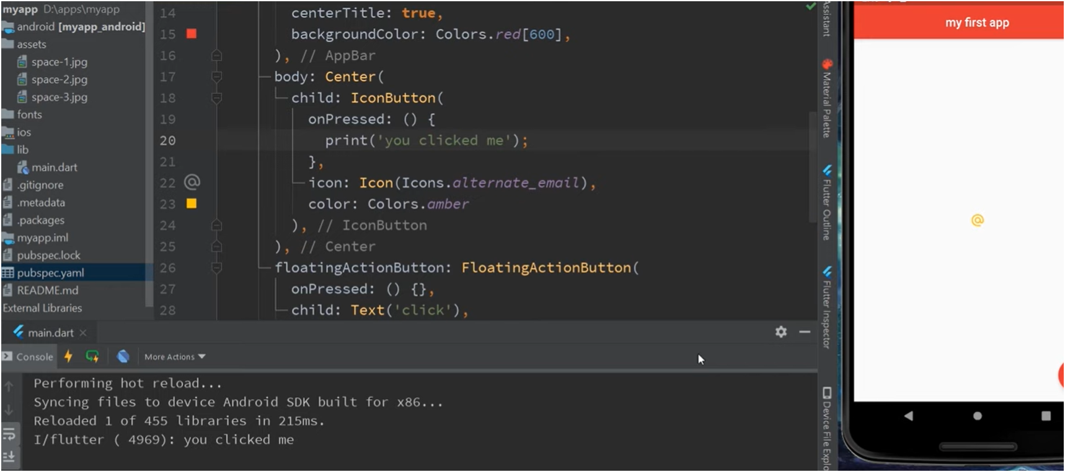
Adding an Icon to the Button
Child: Raisedbutton.icon (this means want an icon inside the button)
Same rules apply as earlier shown earlier
Or you can make the icon as a button shown in the bottom figure
Making the icon appear in the button
You can have an Icon Button

Slide 17
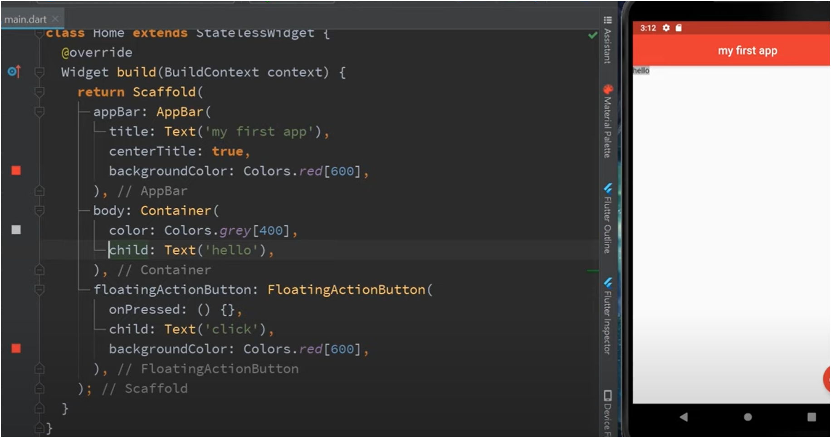
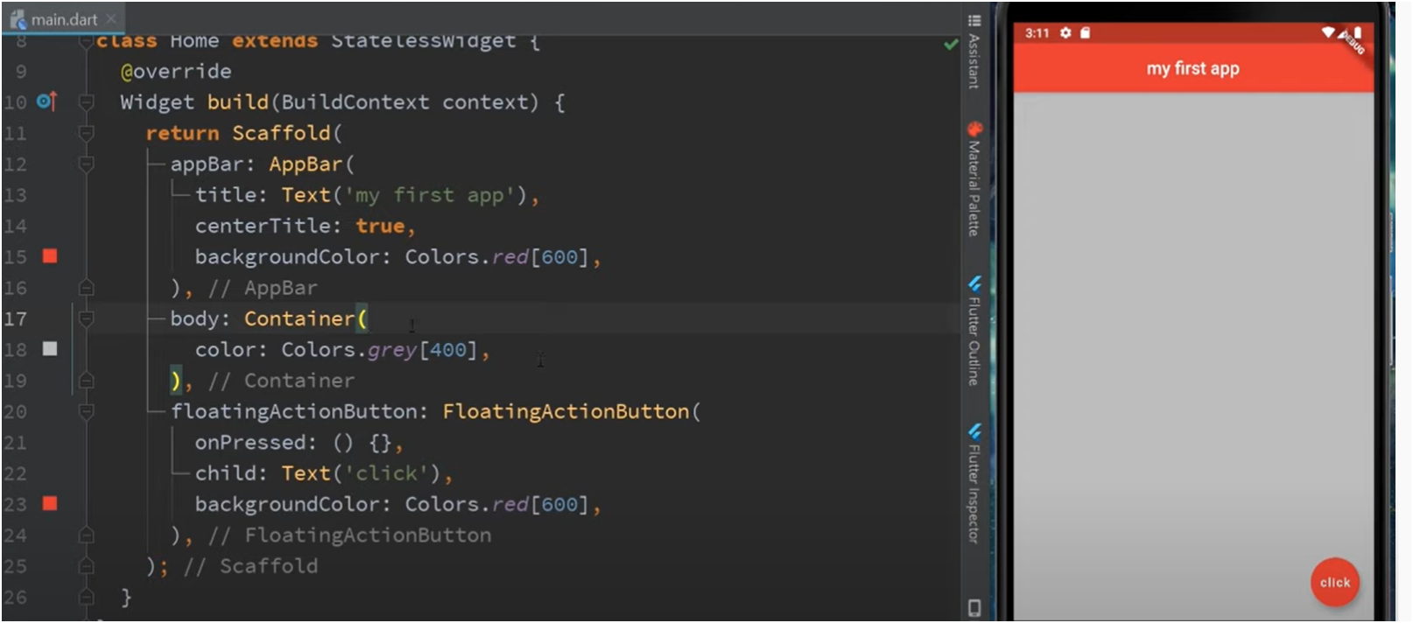
Container
Container widget: it helps contain all of the widgets and it comes with properties like padding, margin and color
Body: Container (container for the widgets
Color: Color. grey[400] (this is the color of the container)
The container is only confined to the child widget text “hello”
This makes the container grey , which is represented by the whole rectangle
17
Notes:
Bottom picture:
Child: Text ('hello'), container the text will appear as hello, but notice now that the grey only surrounds the widget inside and everything else is white. This is because it only covers the container. The container restricts itself to that child widget

Slide 18
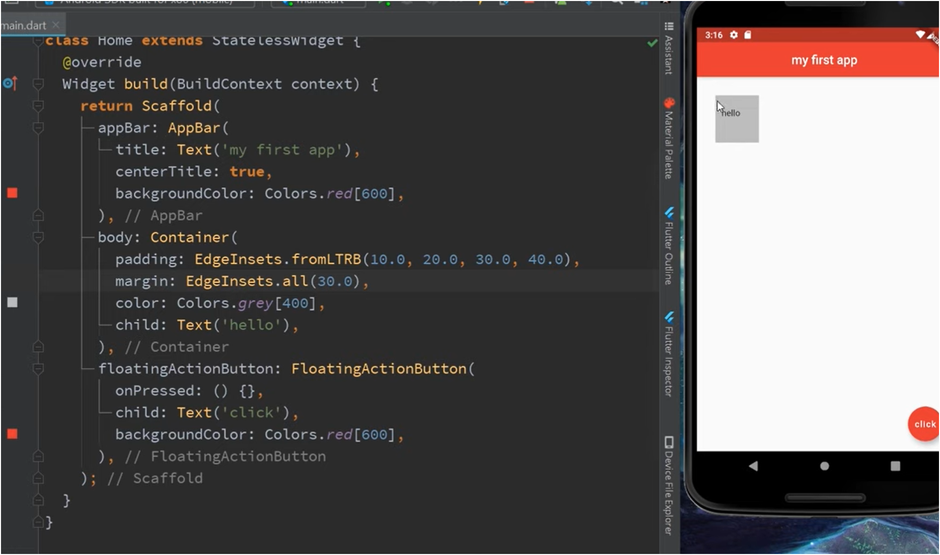
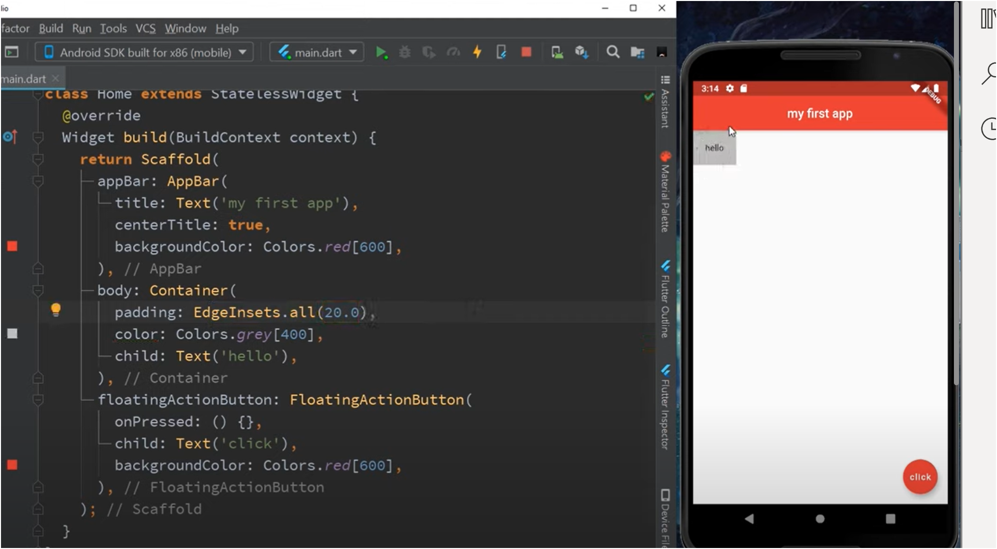

Padding
Can be used to change the container to whatever shape and size
Function: Edgeinsets()
this is how you control padding and margin inside flutter
Margin: is around the container
Padding : EdgeInset.all(20) will add 20 pixels of padding around all edges
18

Slide 19
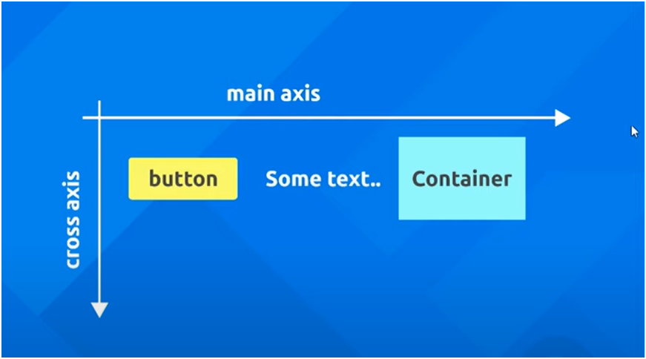
Rows
Within your children widget you can have multiple different rows
Main axis
Allows for a horizontal shift
Function : MainAxisAlignement.()
Cross Axis
Allows for a vertical shift
Function: CrossAxisAlignment.()

Slide 20
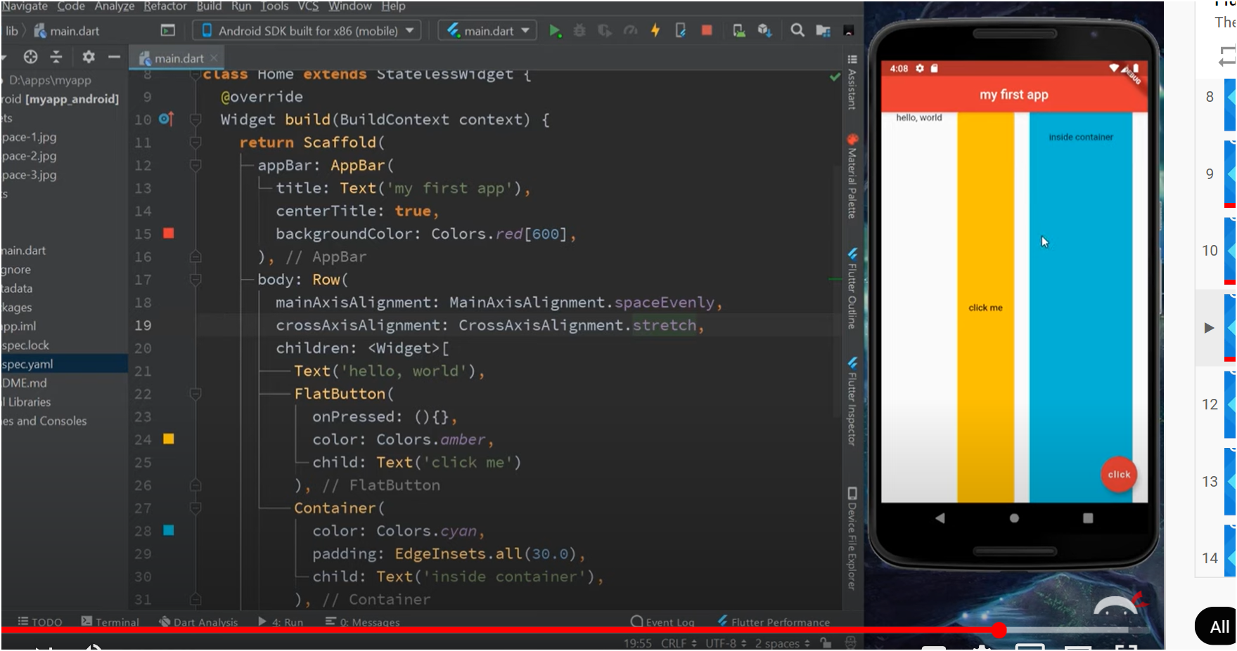
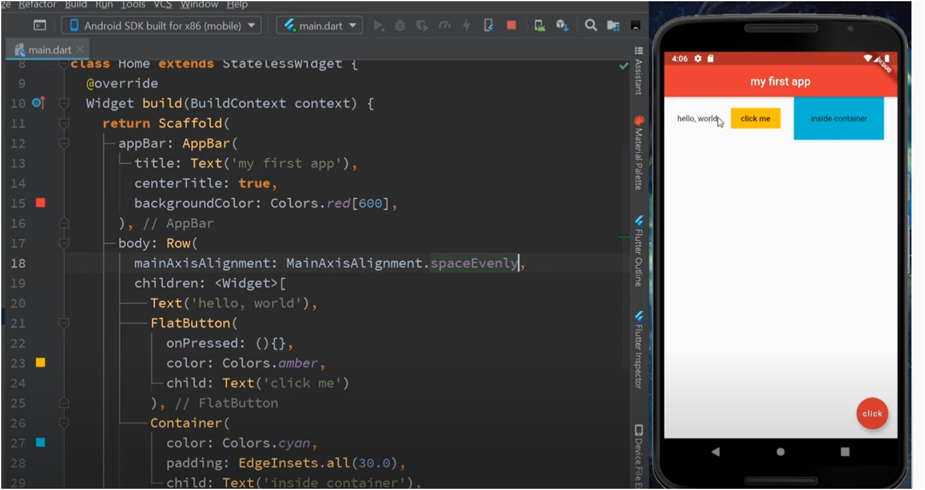
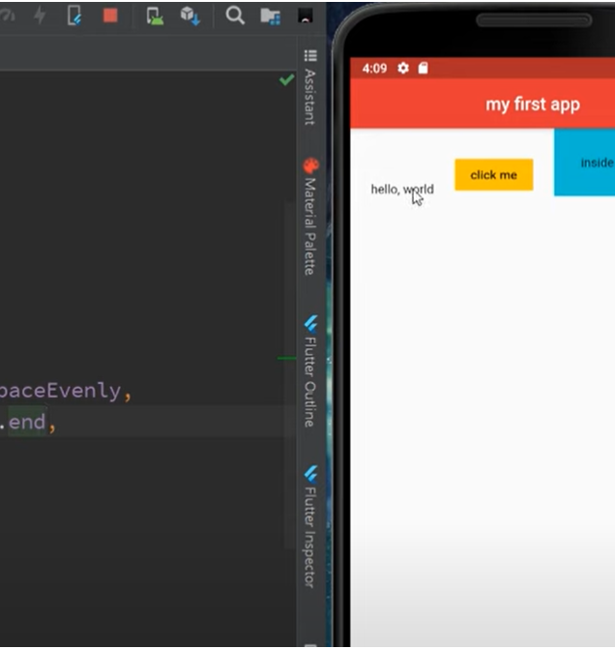
Rows
Figure:CrossAxisAlignment.stretch stretches the widget across the vertical axis
Figure:MainAxisAlignment.spaceEvenly places the widgets evenly along the horizontal axis
Figure:CrossAxisAlignemnt.end allows the smallest widget to be at the bottom of the highest widget along the vertical axis
20

Slide 21
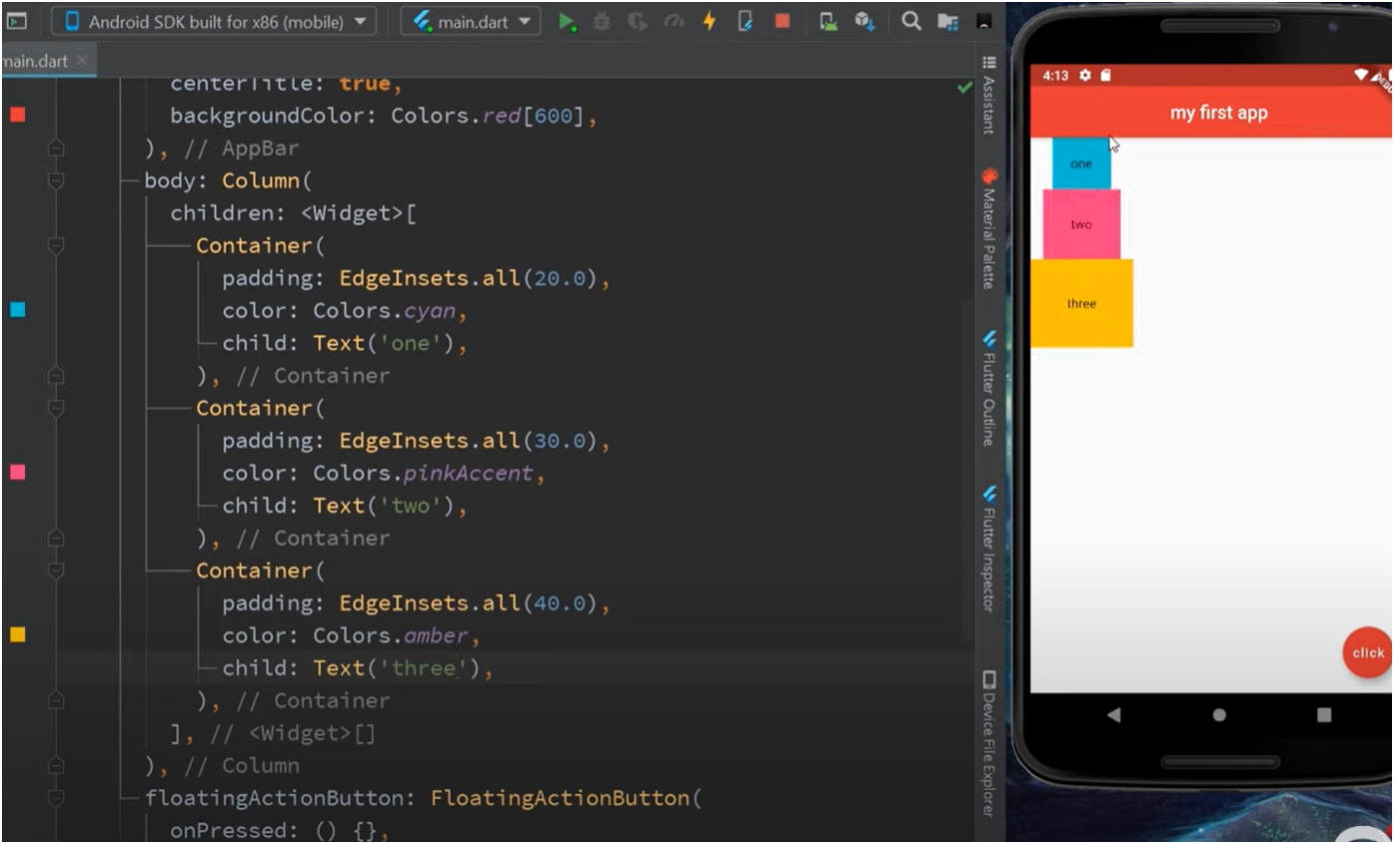
Columns
Elements stacking on top of the other
Main axis
Allows for a vertical shift
Function: CrossAxisAlignment.()
Cross Axis
Allows for a horizontal shift
Function : MainAxisAlignement.()

